Slide 1
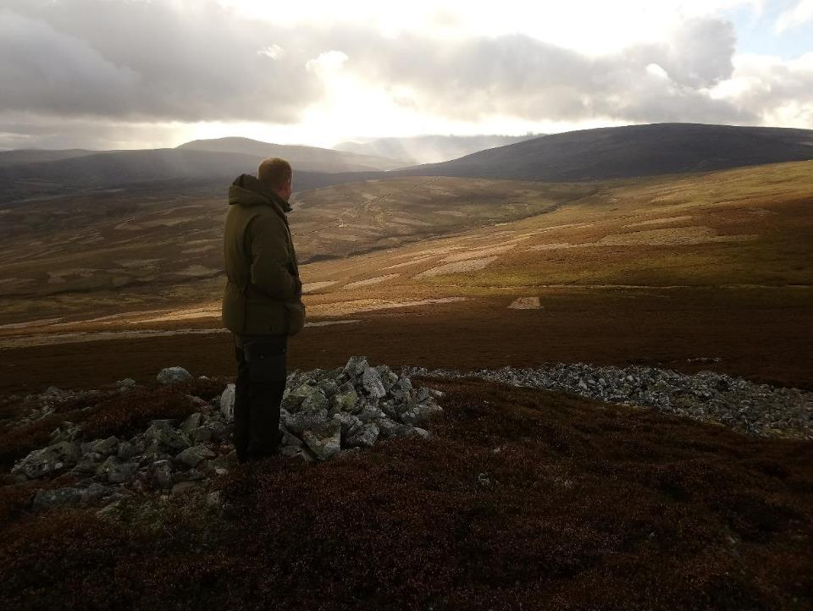
EAST CAIRNGORMS MOORLAND PARTNERSHIP
Jos Milner

Slide 2
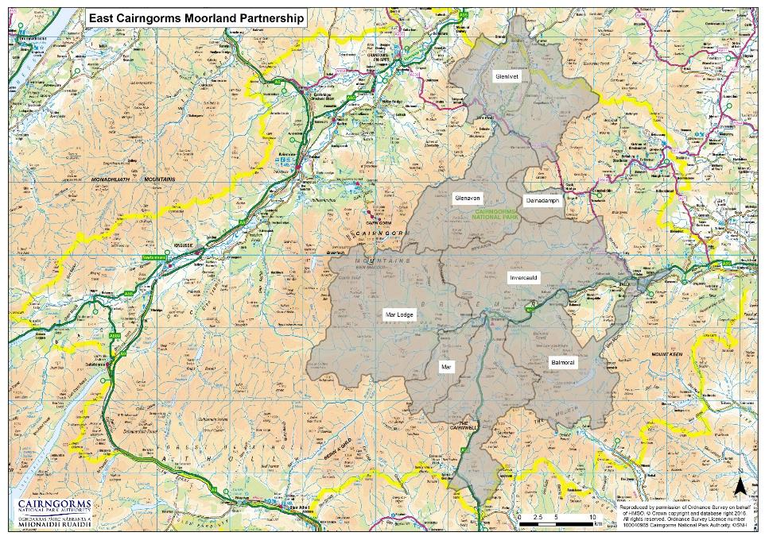
East Cairngorms Moorland Partnership
Partners
Cairngorms National Park Authority
Balmoral Estates
Glenavon Estate
Glenlivet – Crown Estate Scotland
Invercauld Estate
Mar Estate
Mar Lodge – National Trust Scotland
Covers 138,000 ha (c. 30% CNP)

Slide 3
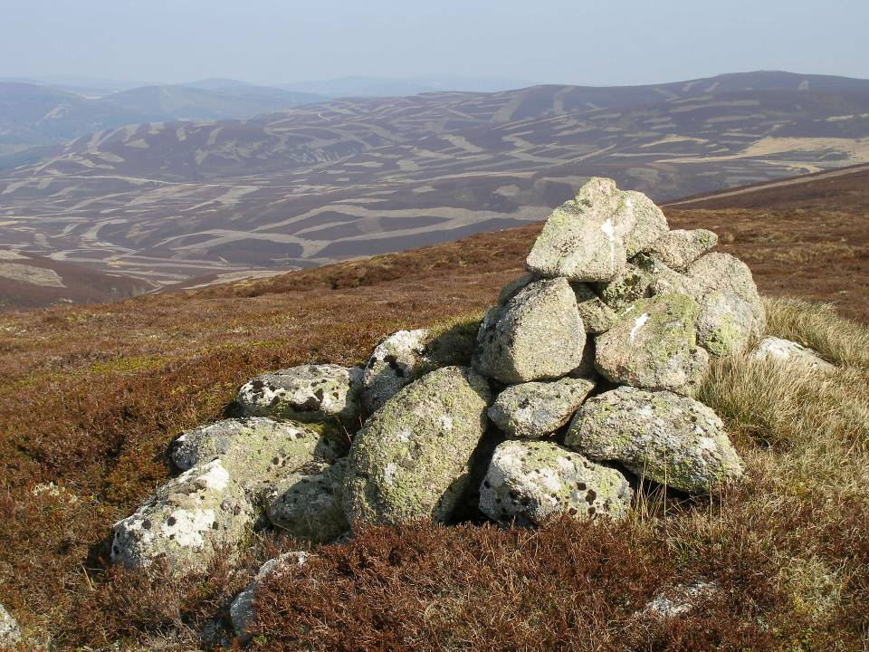
East Cairngorms Moorland Partnership
Objective
Landscape-scale collaboration to deliver public benefits alongside private interests
Woodland & scrub expansion
Peatland restoration
Landscape enhancement
Conservation of raptors & other priority species

Slide 4
East Cairngorms Moorland Partnership
Current projects
Wader productivity monitoring
Mountain hare monitoring
Raptor audit
Mapping muirburn areas
Identifying woodland creation opportunities
Peatland restoration
Public interpretation

Slide 5
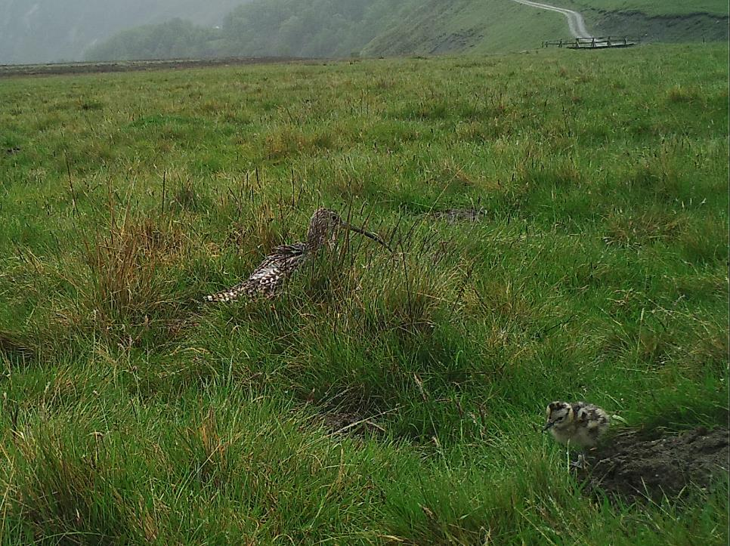
Wader productivity monitoring
Wader monitoring

Slide 6
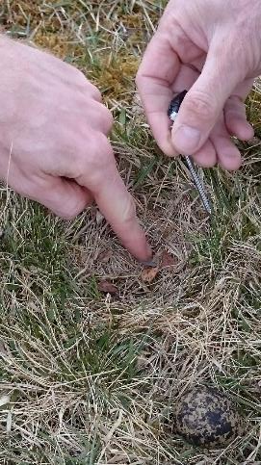
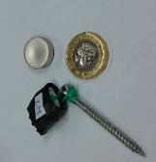
Wader productivity monitoring
Wader nests monitored with temperature loggers
Incubation
Hatching
Incubation
Predation

Slide 7
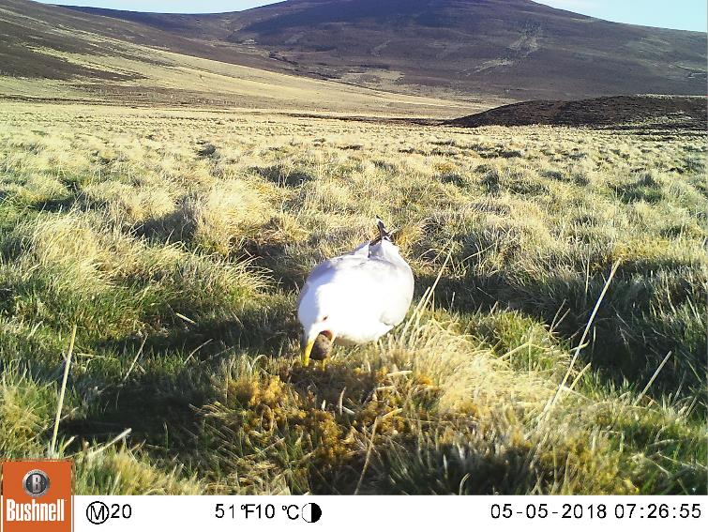
Some nests also monitored with wildlife cameras

Slide 8
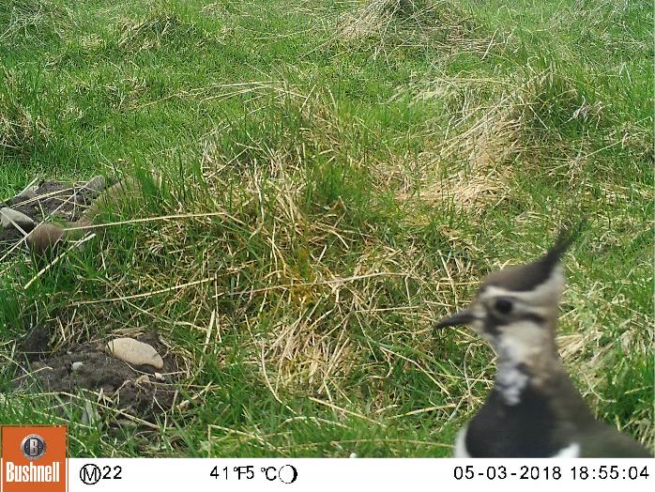

Slide 9
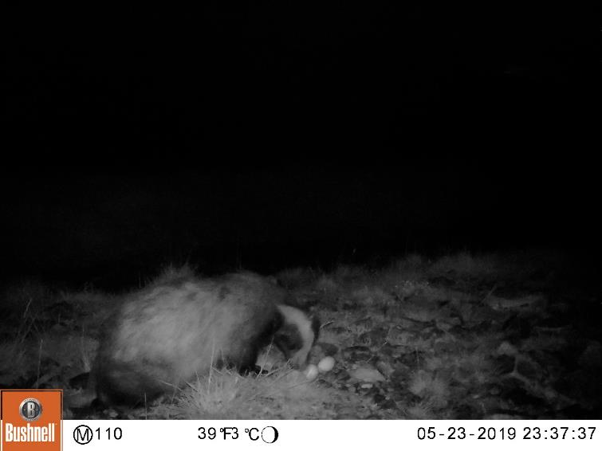

Slide 10
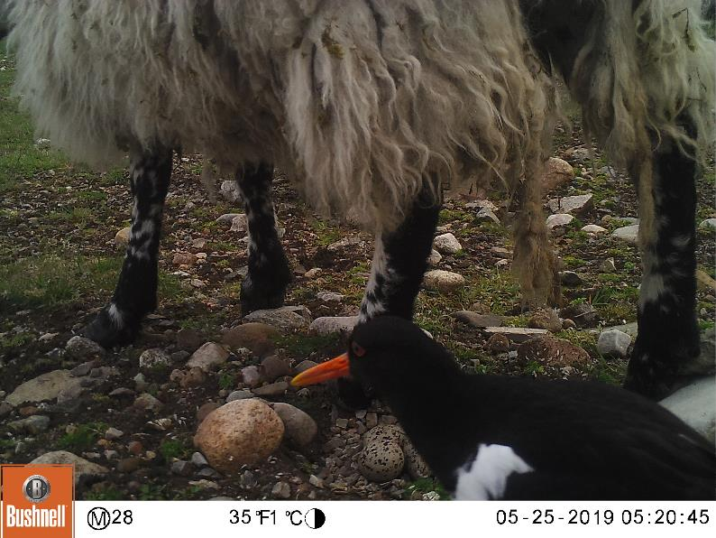
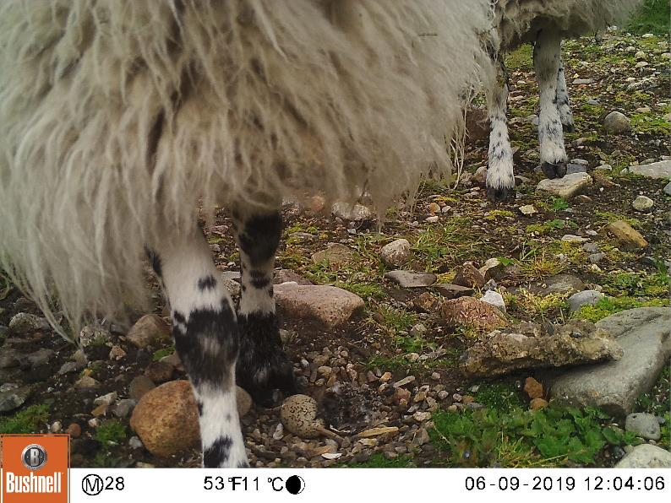

Slide 11
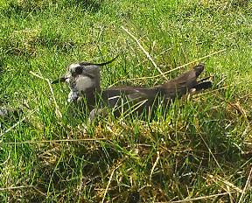
Wader productivity monitoring
Results from 2018 & 2019 seasons
Outcome | Nests
Hatched | 115
Failed | 54
Unknown | 13
Total | 183
 | Outcome
Species | Total | Hatching success
Curlew | 17 | 75 %
Lapwing | 102 | 54 %
Oystercatcher | 59 | 65 %

Slide 12
Wader productivity monitoring
Results from 2018 & 2019 seasons
Cause of Failure | Total no. nests
Abandoned / weather | 8
Agricultural operations | 4
Sheep (trampled) | 1
Sheep (predated) | 1
Badger | 1
Stoat | 3
Pine marten | 3
Jackdaw | 1
Common gull | 2
13 (55%)
11 (45%)

Slide 13
Wader monitoring
Results from 2018 & 2019 seasons
No. nests
Distance to nearest tree (m)
No effect of distance to trees or % woodland cover on hatching success

Slide 14
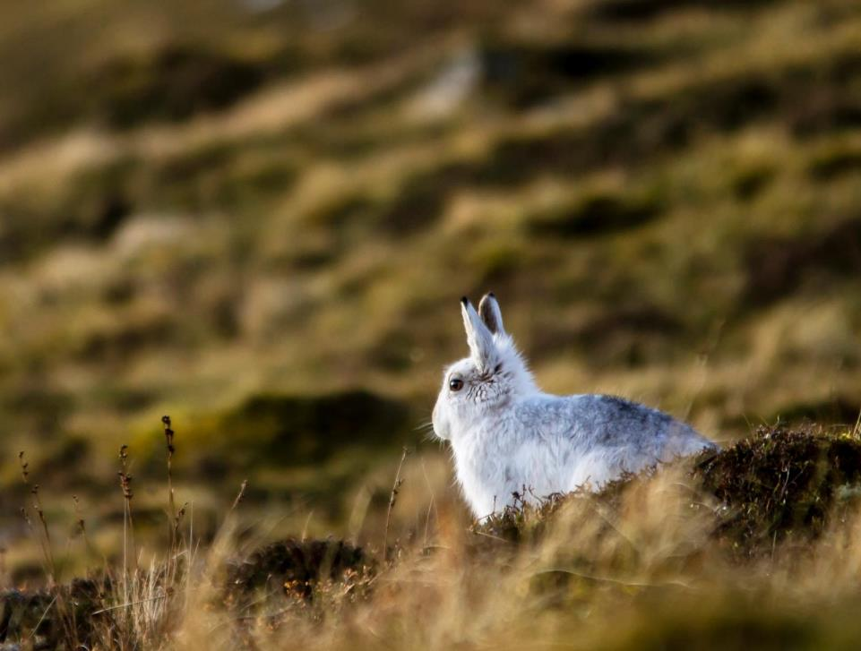
Mountain Hare
Hare monitoring - GWCT training

Slide 15
2018 Encounter rates
Average = 16 hares / km
Mountain Hare

Slide 16
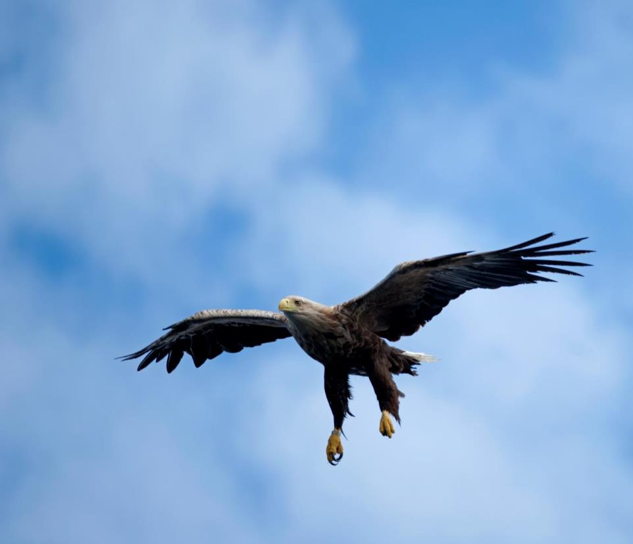
2016-18 ECMP | No. occupied sites
Merlin | 22
Golden eagle | 12
Peregrine | 14
Hen harrier | 3
TOTAL | 51
Raptors

Slide 17
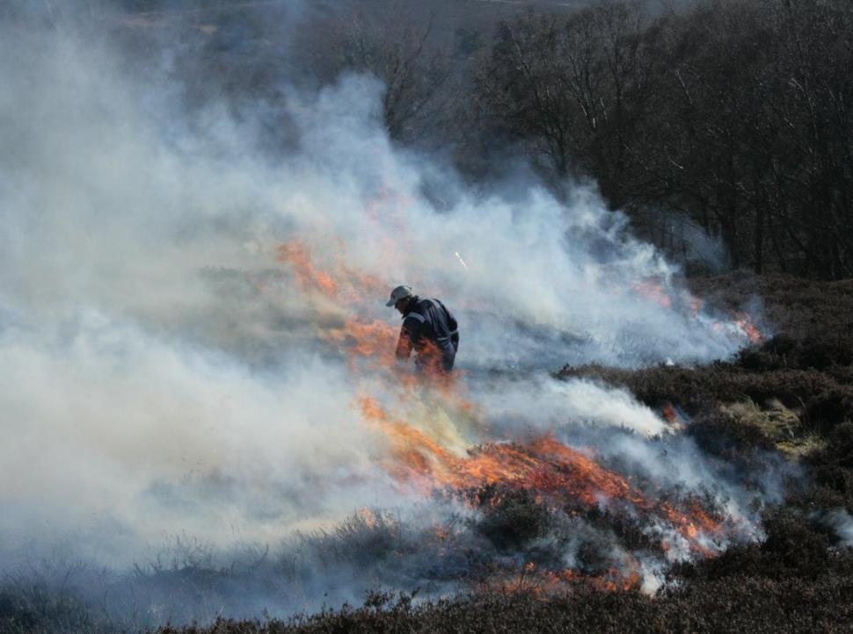
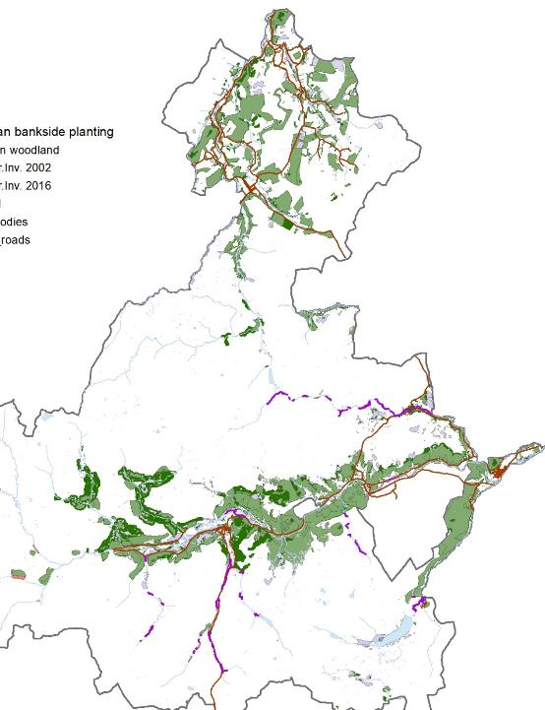
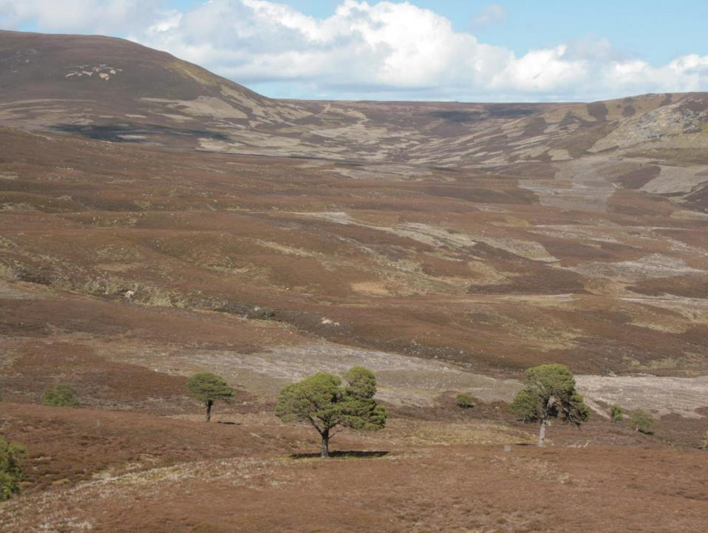
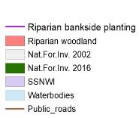
Muirburn
Woodland expansion

Slide 18
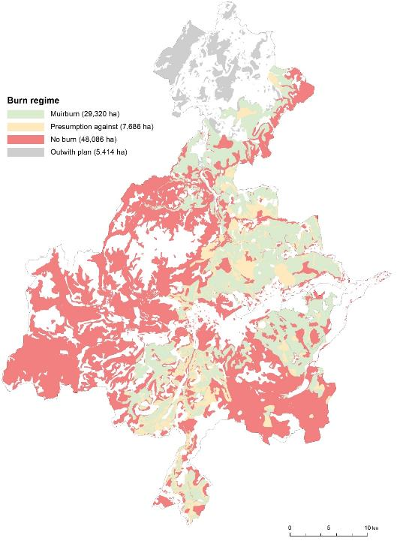
DRAFT
ECMP muirburn map
Muirburn
Woodland expansion

Slide 19
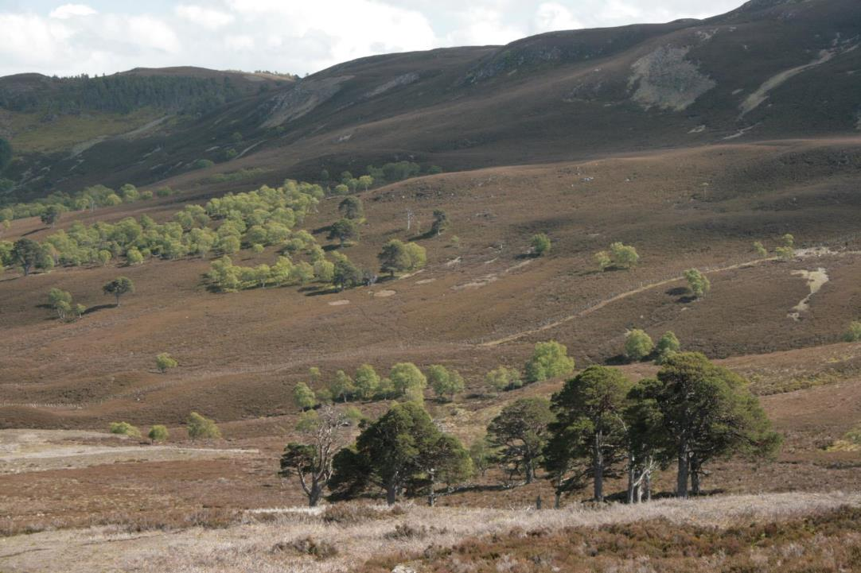
Woodland expansion
Current woodland cover approx. 10 % of ECMP
Expansion across ECMP over last 10 yr: 1,500 ha
Regeneration & planting over next 10 yr: 2,500 – 3,000 ha

Slide 20
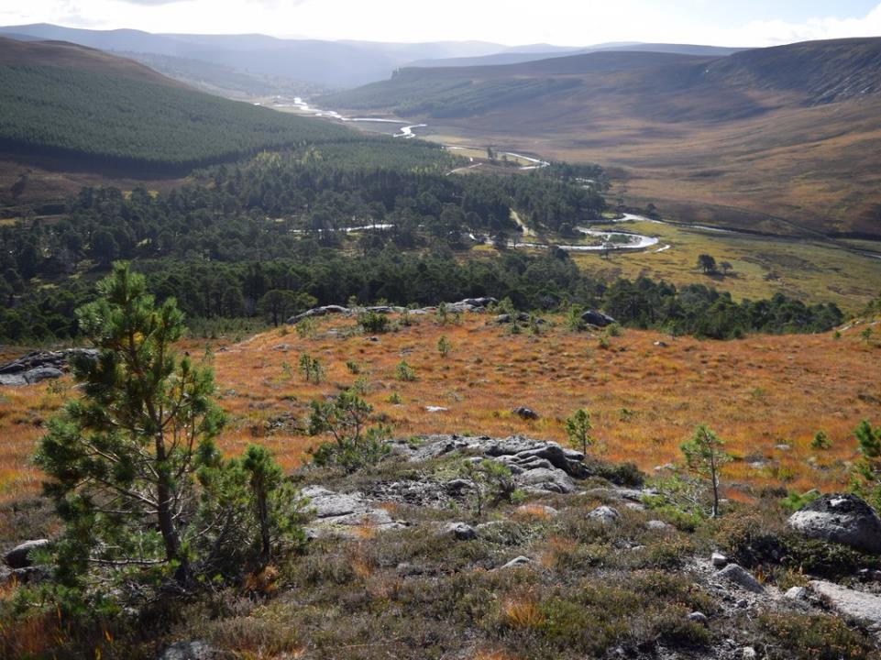
Mar Lodge
1400 ha regen. @ 200 stems / ha over next 5 y
+ 600 ha @ lower stem density

Slide 21
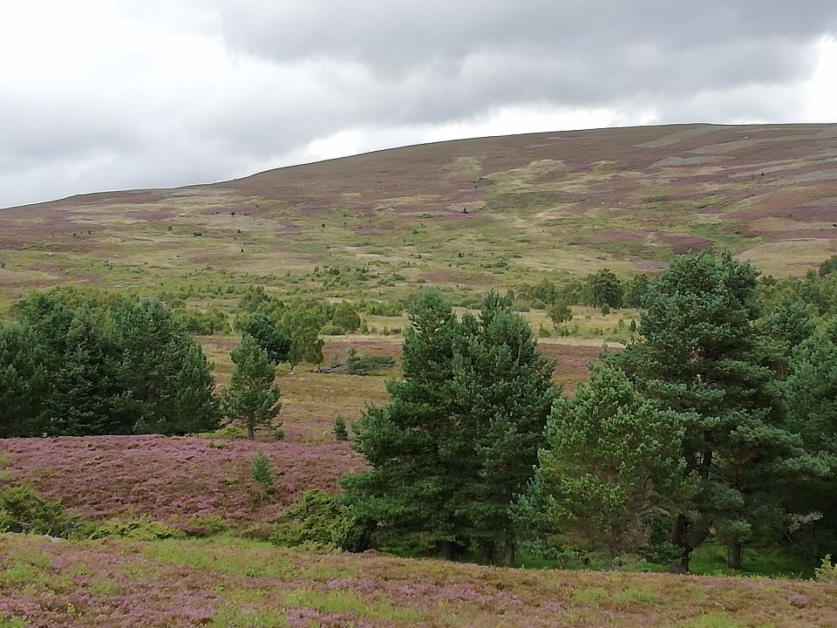
Invercauld
Mapped 260 ha regen. @ 1100 stems / ha
+ 530 ha fenced regen. zone
+ 180 ha proposed new planting

Slide 22
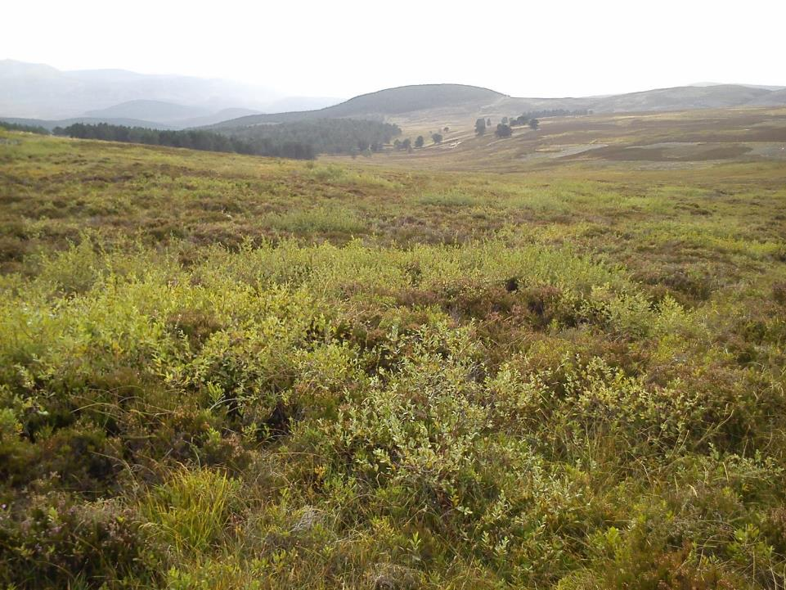
Invercauld
Scrub expansion at woodland / moorland edge

Slide 23
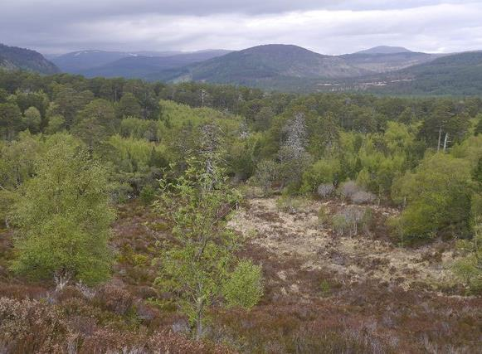
Balmoral
Regeneration at multiple site within fenced exclosures
Glen Muick 80 ha + Ballochbuie 99 ha
+ 46 ha proposed juniper scrub exclosure, Delnadamph

Slide 24
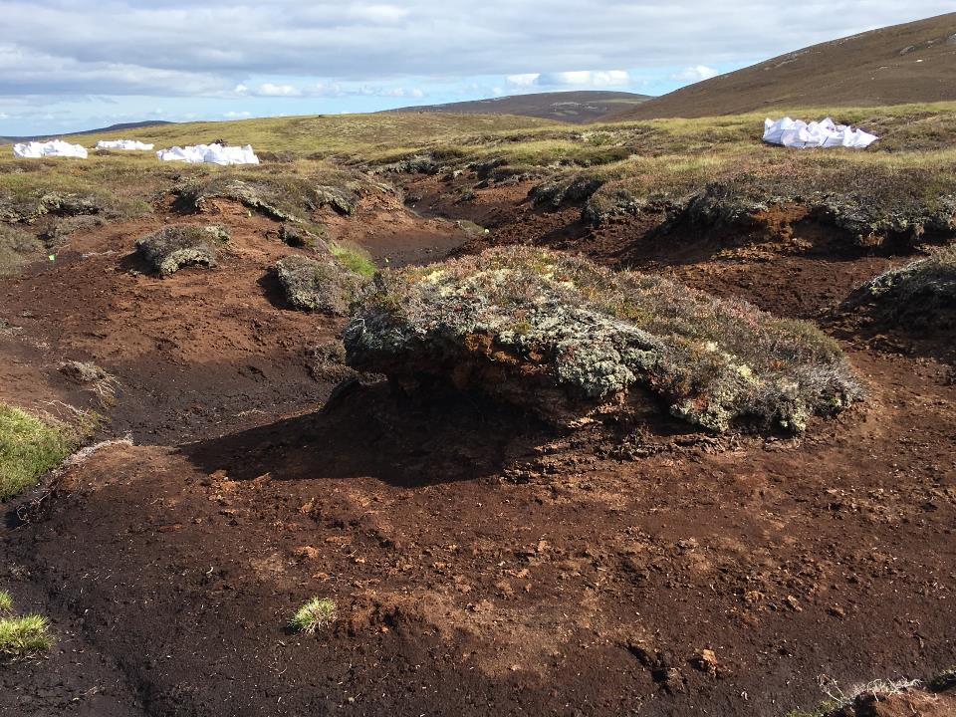

Peatland restoration
700 ha of degraded peatland in ECMP worked on by end of 2018
Equivalent to saving 8,667 t of CO₂ per year
Further 225 ha awarded funding for 2019 but limited by contractor capacity
Peatland restoration

Slide 25
